Slide 1

Diabetes Prediction Using Machine Learning
Diabetes affects millions worldwide. Early detection prevents health problems and saves money.
Our project uses machine learning to predict diabetes risk using the Pima Indians dataset.
By Zagros Baban
Supervised By : Dr.Matteo Francia

Slide 2


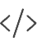

Project Overview
Data Scientist
ML Engineer
Documentation
Cleaned data, created visualizations, built and evaluated the model
Developed and optimized machine learning algorithms
Created report and visualizations for stakeholders

Slide 3




Related Research
Smith et al. (1988)
Used logistic regression with the Pima dataset
Sisodia & Sisodia (2018)
Compared SVM, Decision Trees, and Naive Bayes; SVM performed best
Kavakiotis et al. (2017)
Found Random Forest effective for diabetes prediction
Researchers have applied various machine learning techniques to diabetes prediction. Common evaluation metrics include accuracy, precision, recall, F1-score, and confusion matrices. Most studies emphasize the importance of thorough exploratory data analysis before model building.

Slide 4

Dataset Overview
Source
UCI Machine Learning Repository
Participants
768 women of Pima Indian heritage
Features
Pregnancies, Glucose, BloodPressure, SkinThickness, Insulin, BMI, DiabetesPedigreeFunction, Age
Target
Diabetes Outcome (0 = No, 1 = Yes)
This binary classification problem uses health data to determine diabetes status. The dataset contains more non-diabetic (65%) than diabetic (35%) cases, creating a slight class imbalance that affects model training.

Slide 5
Data Preprocessing
Missing Value Handling
Replaced zeros in health measurements with median values
Feature Scaling
Normalized all features to 0-1 range for better model performance
Data Splitting
Used 80% for training and 20% for testing the model

Slide 6
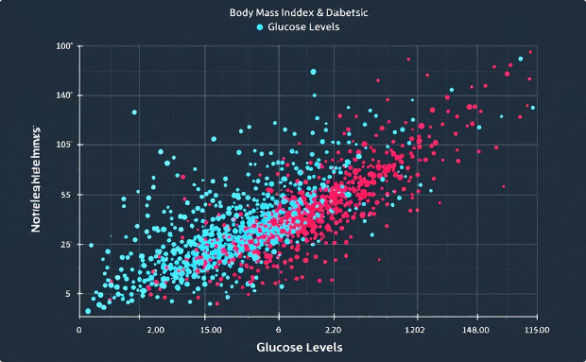
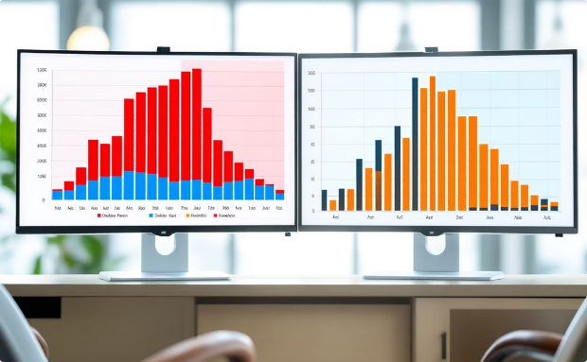
Exploratory Data Analysis
BMI vs Glucose
Higher values in both metrics indicated increased diabetes risk
Age Distribution
Older participants showed higher diabetes prevalence

Slide 7








Why Random Forest?
Prevents Overfitting
Combines multiple decision trees for better generalization
Handles Complex Patterns
Identifies intricate relationships between health metrics
Feature Importance
Reveals which health metrics matter most
Works With Small Datasets
Performs well even with limited data

Slide 8

Results & Conclusions
74%
0.80
Accuracy
F1-Score (No Diabetes)
Overall prediction accuracy
Balance of precision and recall
0.64
F1-Score (Diabetes)
Performance on positive cases
Glucose, BMI, and age were the most important predictors. This matches medical knowledge.
Future work: address data imbalance, try other models, and develop a clinical application.

